Slide 1
Safer Internet Day 2022
All fun and games? Exploring respect and relationships online

Slide 2















How do we use the internet?

Slide 3
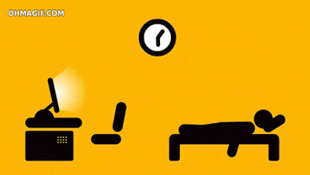
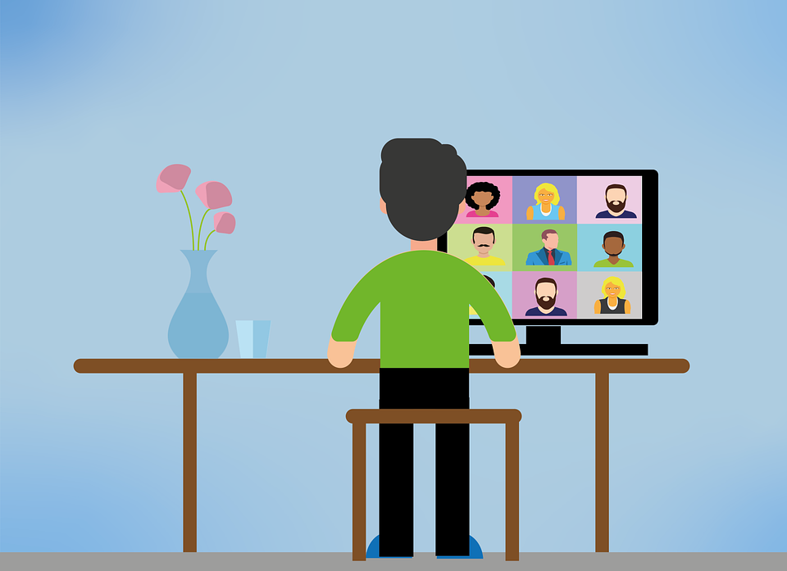
This time last year, everyone’s internet use was very different
Nevertheless, our internet use is still a major feature of most aspects of our lives
The way we communicate and our relationships with each other are no different

Slide 4

What is Safer Internet Day?
Safer Internet Day is an annual event that promotes making the internet a great and safe place for children and young people

Slide 5

Safer Internet Day 2022 - UNICEF Rights of the Child
Article 17 - access to information from the media
Article 31 - leisure, play and culture
Article 34 - governments must protect children from all forms of abuse and exploitation.

Slide 6
Respect and relationships online
What do you think when you hear respect and relationships online?
How does this relate to internet safety?

Slide 7
Respect and relationships online
This year’s theme for Safer Internet Day is ‘All fun and games? Exploring respect and relationships online’

Slide 8


Slide 9
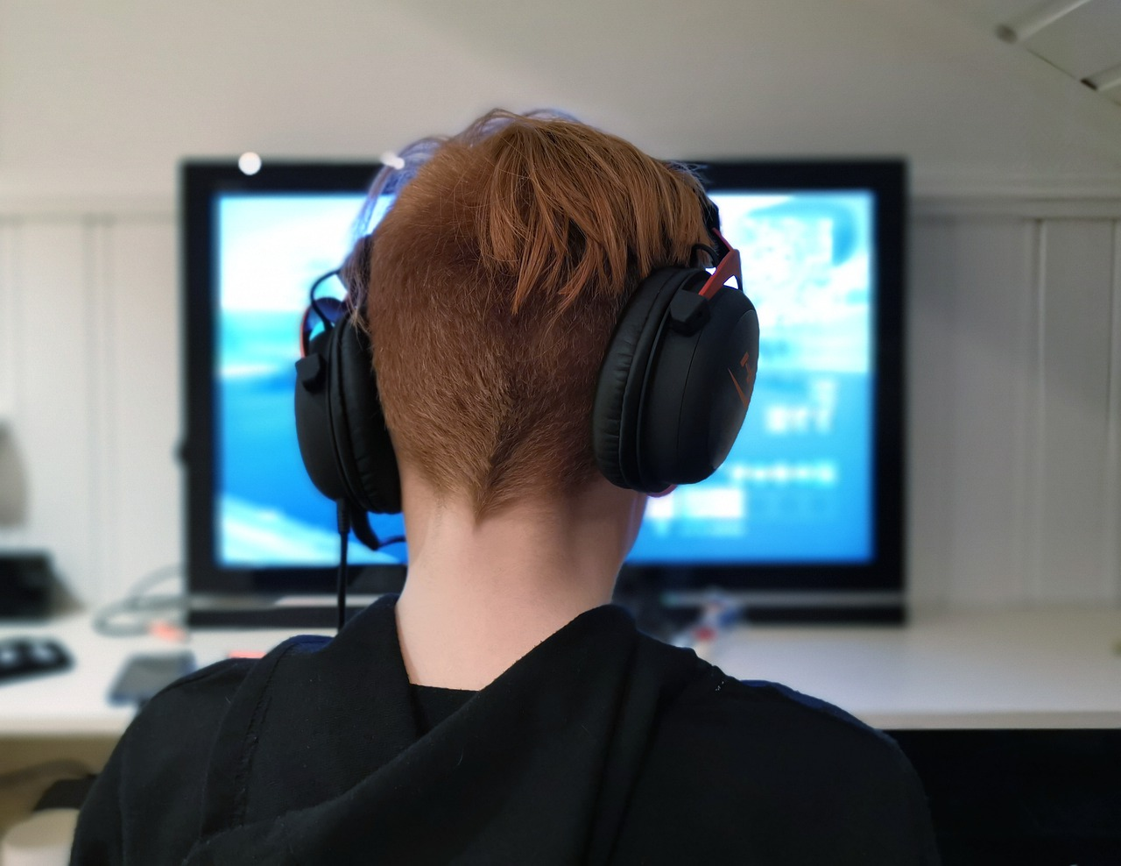
Sometimes it really isn’t all fun and games
The internet is a great resource but some users don’t have the conduct that they might have in real life
‘Trash talk’ can very easily become cyberbullying
If you wouldn’t say something in real life, don’t say it online!
How would you ensure respect and positive relationships online?

Slide 10
How can we ensure respect and positive relationships online?
Virtues and character
Report inappropriate content or conversations
Don’t take part in negative behaviour
Don’t access sites or platforms that aren’t age appropriate
Think before you speak or type
Stop if your emotions are heightened

Slide 11


Slide 12

Finally… are you following the rules around internet use?
Minimum age for Snapchat - 13
Minimum age for WhatsApp - 16
Minimum age for TikTok - 13
Minimum age for Instagram - 13
Minimum for Discord - 13

Slide 13

Tips for respect and positive relationships online
If you wouldn’t say it in real life, it’s probably offensive
Don’t share personal details about yourself or anyone else
Don’t engage in negative conversations
Don’t allow your emotions to control you
Report inappropriate conversations or content
Don’t use platforms or sites that aren’t age appropriate

